Slide 1
DOES MAKING A COACH CHANGE DURING A SEASON IMPROVE TEAM PERFORMANCE?
Team 48

Slide 2
Motivation
Firing the manager in a poorly performing business unit is a drastic measure employed by firms. However, data and causal analysis of 'within-firm dynamics' are scarce. This makes the value of firing a manager challenging to assess.
Data on sports offer a unique opportunity to study this phenomenon because the firing of a coach is usually well-publicized and common practice. Using data on soccer, we can evaluate the effect of the firing of a coach midseason on team performance. As teams typically do not face the same opponents repeatedly before and after a coach is fired, the issue of sample selectivity is nullified.

Slide 3
Literatures - Previous Reports
According to a paper published in 1995, it was found that NBA, MLB, NFL & NHL teams that performed relatively poorly (losing more games than they won) had an improved team performance after coach replacement. The performances were significantly better after the coach change (P<0.001).
In July 2011, Carlos Lagos Penas conducted a similar study for the Spanish Soccer League for seasons 1997-1998 to 2006-2007. To conduct his tests, he used two regression models. In the short term, the performance of the team improved by 20% at 99% level confidence. In the long term, the every day team performance worsened by 1.21%.
According to the analysis by a study about professional soccer, the goal difference for teams before and after the coach change significantly improved from xGd = −0.5 to xGd = −0.25 [For detailed explanation on expected goal differential (xGd), please refer to the Appendix].

Slide 4
Our Approach at a Glance
For our data, we considered 5 Major European Soccer Leagues, namely, La Liga (Spain), EPL (England), Bundesliga (Germany), Serie A (Italy), and Ligue 1(France). We collected data for matches in these leagues for years 2014 to 2020.
We conducted a Simple Pooled OLS and a Panel Model for our analysis.
For our analysis, we looked at the expected goal difference (xGd) between the teams and their opponents before and after the coach change.

Slide 5
Data - Data Source
Data set 1
Taken from kaggle, created by understat.
It contains Xg and xGA (using OPTA’s model) on a per-game basis for every team in Europe’s top 5 leagues (English Premier League, Spanish La Liga, German Bundesliga, Italian Serie A, and French Ligue 1), spanning from 2014 to 2020. We will be analysing the club names, xG (expected goal of analysed team) and the xGA (expected goal of opponent team).
Data set 2
Web scraped data for 2014 to 2020 from Transfermarkt.
We manually gathered the data of different clubs and coaches from the site. Our dataset includes club name, league name, name of coach who got changed, date coach got changed, coach successor, pre-change team ranking & points per game, post-change team ranking & points per game, the coach tenure & the rank of game in the season.

Slide 6
Data - Data Preparation
Target Variable selection
We chose Expected Goals Differential because it serves as an objective measure of team performance and eliminates bias that may come in the form of luck or individual player ability (Having a player like the three referenced in the video would make the team’s performance seem better than it actually was.)
Data Preparation
We only considered teams to be a part of the treatment group if they changed their coach within the season, rather than changing their coach at any point in time. Additionally, we set our window of measurement to be a single season. This reduces error caused by organizational or personnel changes that are common during the offseason. Additionally, we filtered out coaching changes that occurred within five games of the first or final matchday. This is because five games is not a large enough sample size to extract value from.

Slide 7
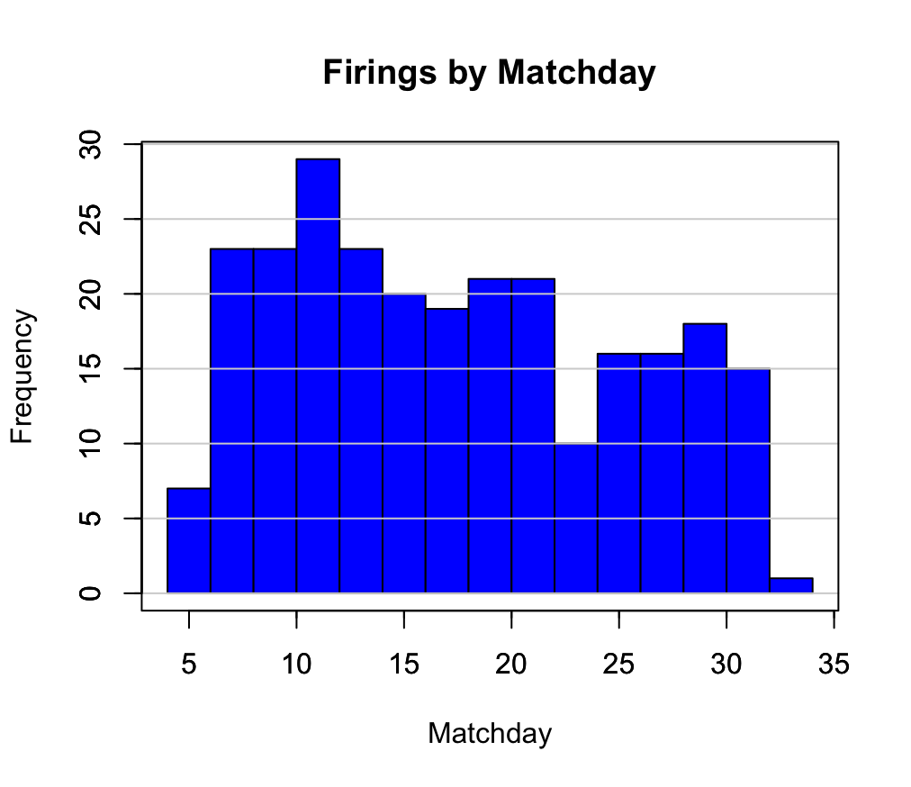
Data - Exploratory Analysis
The visualisation depicts the number of coaches fired and the day they were fired on.
We can observe that majority of the coaches were fired after the 10th MatchDay. There were hardly any instances of coach being fired after 32nd MatchDay.
Most soccer leagues have a 38 matchday season.

Slide 8
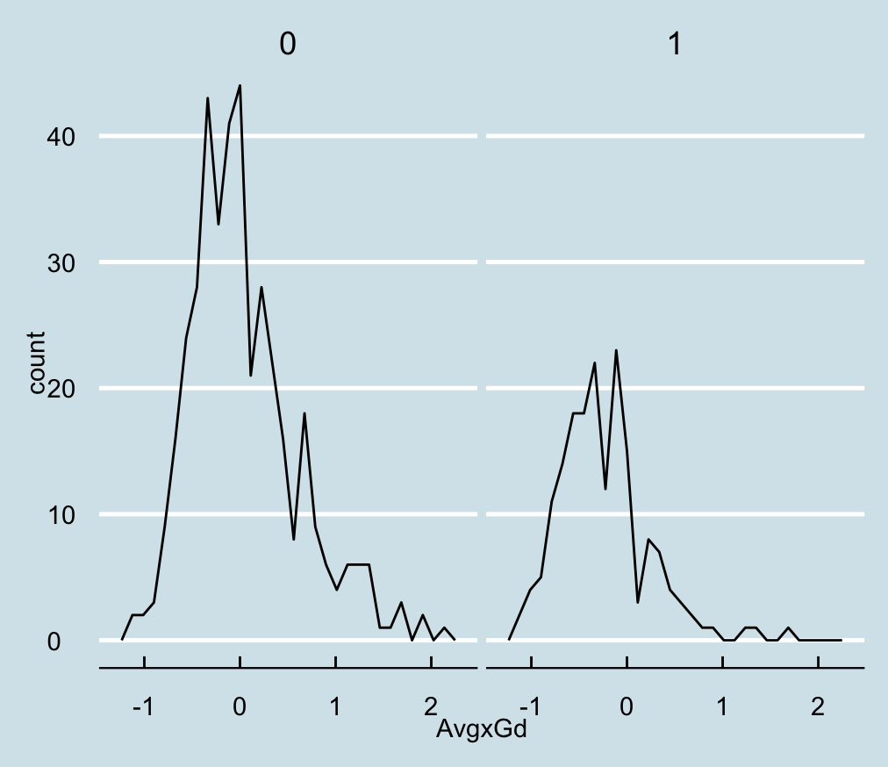
Data - Exploratory Analysis
The graph displays the distribution of average expected goal differential of teams with and without coach change.
In the graph, 0 implies the coach is not fired and 1 implies the coach was fired. We can see that more teams without coach change had a higher goal differential than teams with coach change, suggesting they performed better.
This may contain bias as the literature has defined poor performance as a driver of a team changing its coach.

Slide 9
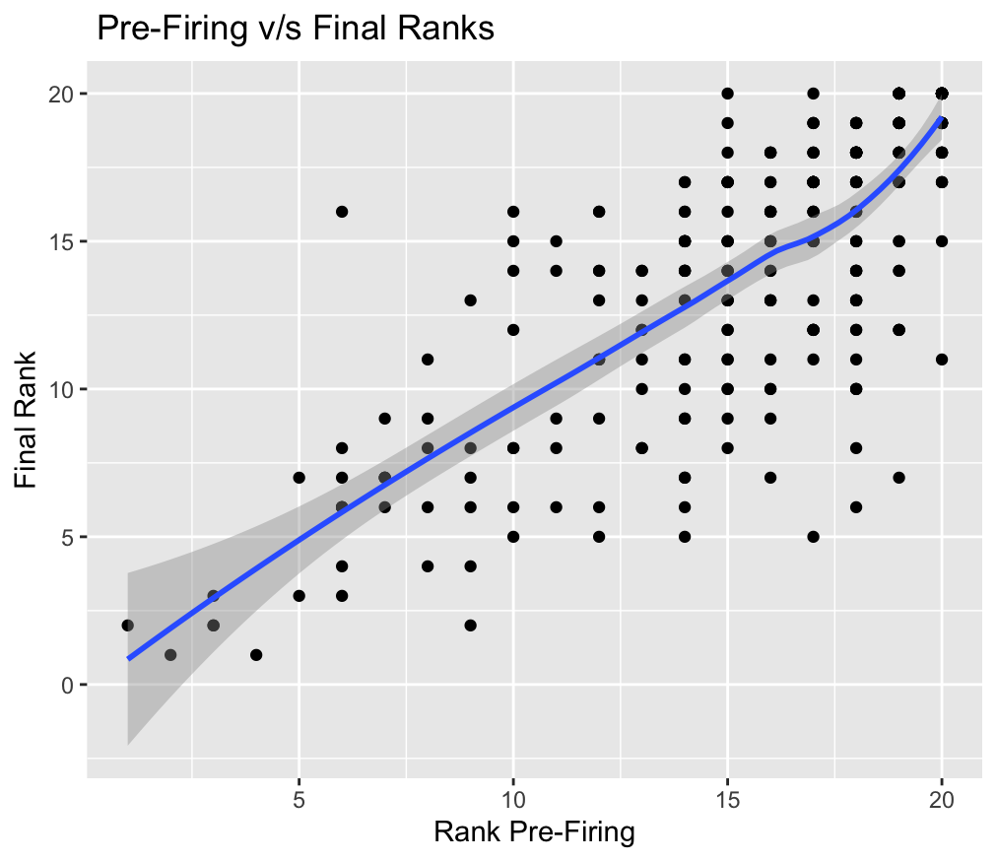
Data - Exploratory Analysis
The scatter-plot displays the pre and post coach change ranks of the teams.
We can infer that there was no observable changes in team ranks after coach dismissal based on the average trend.

Slide 10
Methodology and expected result
Causal question of interest:
Our causal question of interest was to determine if changing coaches mid season improved or declined team performance.
For this analysis, we decided to look at european football teams. We picked expected goal difference (xGd) as the metric of team performance. We decided to look at the expected goal difference of selected and opponent team for before and after coach change. So if the goal difference is positive, we can conclude that the team’s performance improved after coach change. If the goal difference is negative, we can conclude that the team’s performance declined.
Expected result:
Based upon our research, we expected to see a positive change in xGd after a coaching change.
H_{A} <- [xGd | change = 1] - [xGd | change = 0] > 0
H₀ <- [xGd | change = 1] - [xGd | change = 0] ≤ 0

Slide 11
Methodology - Simple Pooled OLS
We implemented a simple pooled OLS as a baseline model.
We have observations from two groups:
Treated: Teams who change their coach during the season (treated = 1)
Untreated: Teams who employ the same coach for the entirety of the season (treated = 0)
We standardized time by taking the average xGd, treating the moment the team changed their coach as T=0.
Before Coaching change: (change = 0)
After Coaching change: (change = 1)
xGd = β₀ + β₁*(treated i) + β₂(change i) + δ₁(treated i *change i) + e(i)
δ₁= Treatment effect estimate

Slide 12
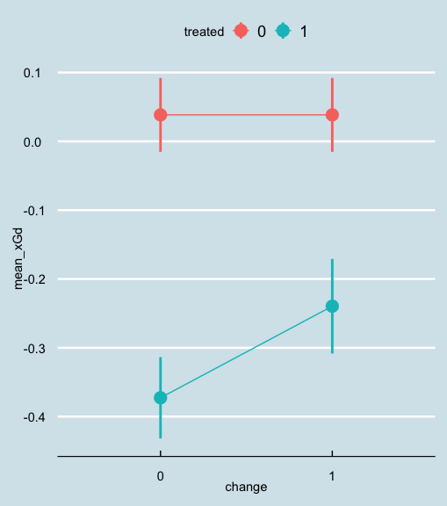
Findings - Simple Pooled OLS
If you used the simple regression model:
lm(avgxGd ~ treated + change + (change*treated))
You would observe a statistically significant (95% confidence level) improvement in average expected Goal Differential after a team changed their coach of 0.133.
However, this is approach is overly simple and fails to take into account possible confounding variables
To overcome these limitations, we will explore Panel Regression, which will allow us to introduce controls into our model.

Slide 13
Methodology - Panel Regression
We have panel data with N = 143 (i.e. 143 teams) and T is around 6*38 (6 seasons * 38 match with certain exceptions).
We used LSDV (least squares dummy variable) model because it accounts for endogeneity of some of the variables:
Team: there are differences in the team’s skills and rankings, which would affect xGd
Season: a team’s performance may vary a lot across different season
Matchday: the team’s performance may vary within the same season
Conceptually, we set out the model for performance of a team in a match as following:
xGd = β₀ + β₁*Treatment + v(Team) + α(Season) + w(Matchday) + u(i,t)
= β₀ + β₁*Treatment + ΣGamma_{j}*Team + ΣGamma_{k}*Season + ΣGamma_{n}*Matchday + e(i,t)
The LSDV model will assume fixed effect across different team, season and matchday.

Slide 14
Findings - Panel Regression
We used two methods to calculate the coefficient of Treatment on xGd in R:
lm(xGd ~ Treatment + factor(team) + factor(season) + factor(Matchday))
plm(xGd~Treatment, index = c("season&Matchday","team"), model="within",effect="twoways")
The two methods gave us similar results. The coefficient (β₁) is around -0.23 (with minor rounding difference), and the p-value is significantly low.
The negative coefficient suggesting changing coaches would made the team perform worse.
Our findings were not in line with the short term findings of most reports, but were reflected the long term results of the reports.

Slide 15
Limitations
Some limitations to our analysis was that there are probable confounding variables that were not measured within our data. We only had data on goal difference between teams before and after coach changes. If we had looked at other statistics (for example opponent performance, player health, etc.), we would have been able to depict a clearer picture.
Moreover, we only looked at the european soccer league and did not include other sports or leagues in our analysis.

Slide 16
Conclusion
A Simple Pooled OLS regression seems to support our Hypothesis that there is a positive change in xGd after a coaching change. However, this fails to account for confounding variables. Using a Panel Regression, we can observe the impact of a coaching change on team performance more accurately.
According to our data, a midseason coaching change would adversely affect team performance. At a 99.99% confidence level, there is insufficient evidence to warrant rejection of the null hypothesis.
Given the data we collected, this is the best observation possible. In order to further explore the causal relationship between mid season coaching changes and subsequent team performance, more extensive data could be beneficial.

Slide 17
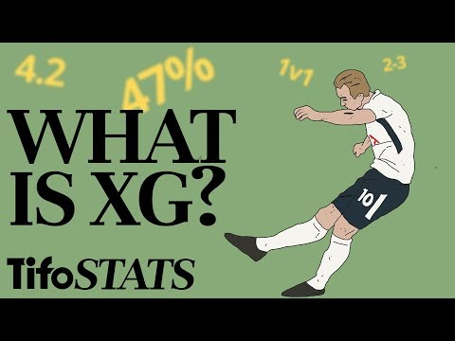
Appendix: What is Expected Goals [xG]?

